Slide 1
The Effect of Shortened Work Week on Economic Outcomes
Karsen Brantley
TJ Tracy

Slide 2
Introduction
I had an internship in the summer of 2022, and I found myself without any tasks at least two out of five days a week. I wanted to see if the 4-day work week would be an effective option for companies to implement. Mainly, I am interested in the effect of a shortened workweek on labor productivity.
There has been a lot of push around the globe for a 4-day work week. An organization called ”4 Day Work Week Global” pushes to implement the 4-day work week into the future of the workforce.
Additionally, several countries worldwide are exploring or implementing the 4-day work week. The countries include Iceland, Japan, Spain, Scotland, Ireland, United Arab Emirates, the United Kingdom, Belgium, Lithuania, and South Africa. There has also been a push in the United States to move to a 4-day work week.

Slide 3
Introduction
Recent European policy changes have caused many countries to adopt shorter work weeks with the goal to improve worker productivity and quality of life.
Research following the policy changes involve two primary subjects. Literature has been published concerning the effects of the shortened work week on labor health and productivity.
Our research seeks to add to the existing literature by reinforcing the data on labor productivity. While introducing possible effects on CO2 emissions and provide insight into labor productivity by analyzing multiple industries.

Slide 4
An area of literature analyzes the relationship between working time and health outcomes. The study, published by Taehyun Ahn in 2015, found an increase in one hour of work per week had a negative effect on the amount of exercise a person performs, as well as a positive effect on the amount of smoking and drinking they take part in.
Another large area of the literature focuses on the relationship between workload and worker productivity. Many papers have significant findings, such as an article by Sheikh Ali, published in 2013, found that a significant workload reduced workers’ productivity. On the other hand, Emi Okazaki and five other authors, published in 2018, among others, found that working hours do not significantly affect productivity.
Introduction

Slide 5
Methodology
Our treatment group is Iceland. Iceland recently underwent trials which introduced a four-day workweek across the country.
Towards the end of the trials, in 2021, around 86% of the country’s labor force had the option to incorporate a shorter work week.
Our paper looks to use these trials to evaluate the effects of a shortened work week on three different economic outcomes: industry (further broken down into six subgroups), labor productivity, and emissions.

Slide 6
Methodology
Three difference-in-difference regression models are run to compare the outcomes between a control group and a treatment group.
The control group consists of Ireland, Norway, Denmark, and the Netherlands.
The countries in the control group are included due to their similarity to Iceland. Mostly their similarity in geographic location, population, and economy.

Slide 7

Models
Model 1
$Industry=β_{0}+ β_{1}AdultEduc+β_{2}HoursWorked+ β_{3}WorkingAgePopulation+ β_{4}TreatmentGroups+β_{5}PostTreatmentGroups+β_{6}TreatmentGroups∗PostTreatmentGroups+ ε$

Slide 8

Models
Model 2
$Labor Productivity=β_{0}+ β_{1}AdultEduc+β_{2}HoursWorked+ β_{3}WorkingAgePopulation+ β_{4}TreatmentGroups+β_{5}PostTreatmentGroups+β_{6}TreatmentGroups∗PostTreatmentGroups+ ε$

Slide 9

Models
Model 3
$Emissions=β_{0}+ β_{1}GDPperCapita+β_{2}FreightTransport+β_{3}MaterialConsumption+ β_{4}TreatmentGroups+β_{5}PostTreatmentGroups+β_{6}TreatmentGroups∗PostTreatmentGroups+ ε$

Slide 10
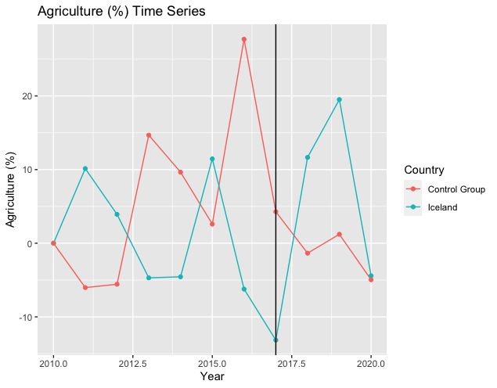
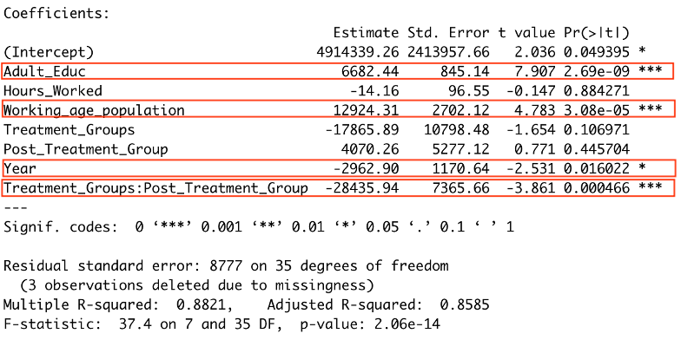
Difference-in-Difference Results: Industry

Slide 11
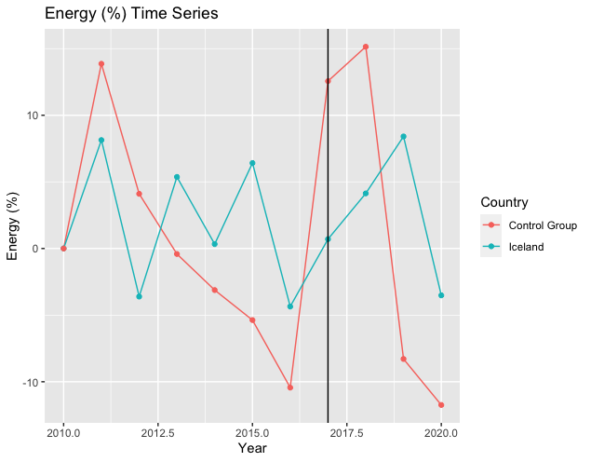
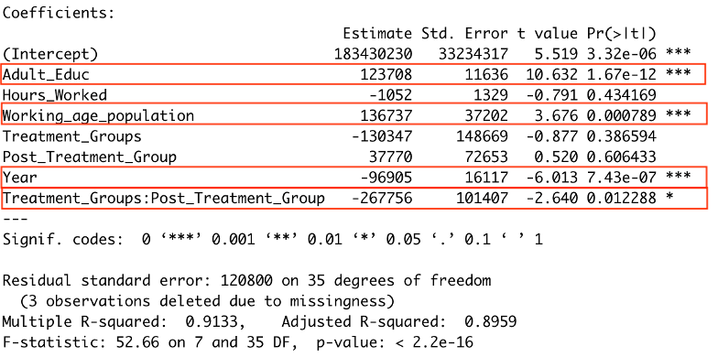
Difference-in-Difference Results: Industry

Slide 12
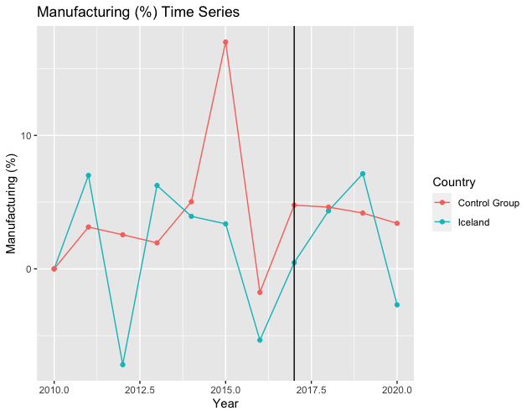
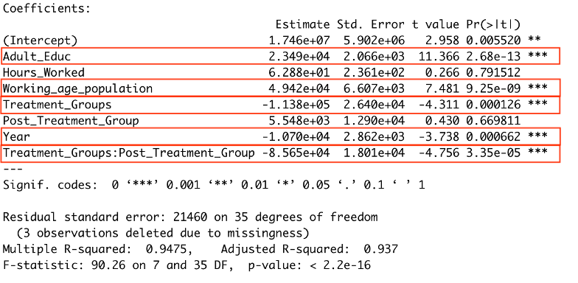
Difference-in-Difference Results: Industry

Slide 13
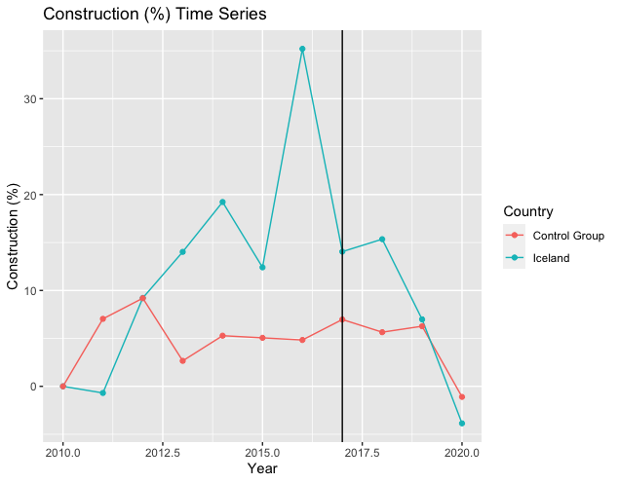
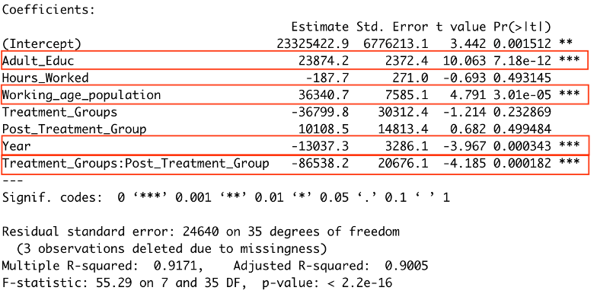
Difference-in-Difference Results: Industry

Slide 14
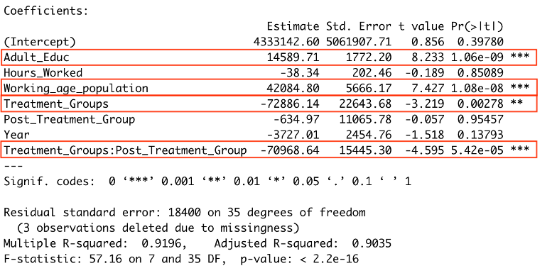
Difference-in-Difference Results: Industry

Slide 15
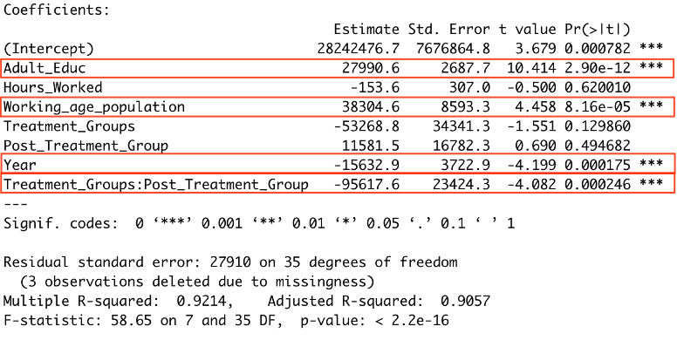
Difference-in-Difference Results: Industry

Slide 16
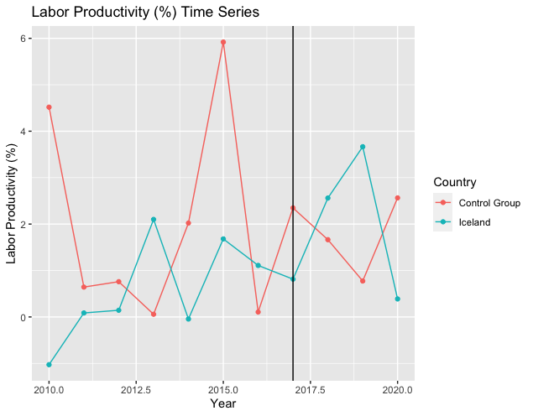
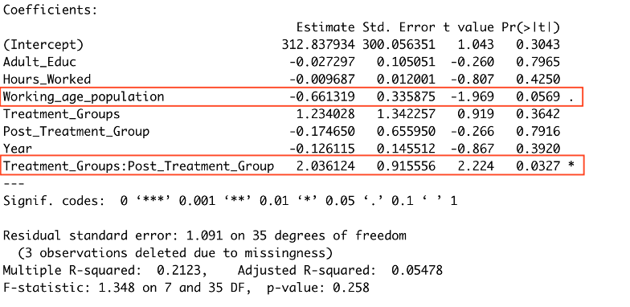
Difference-in-Difference Results: Industry

Slide 17
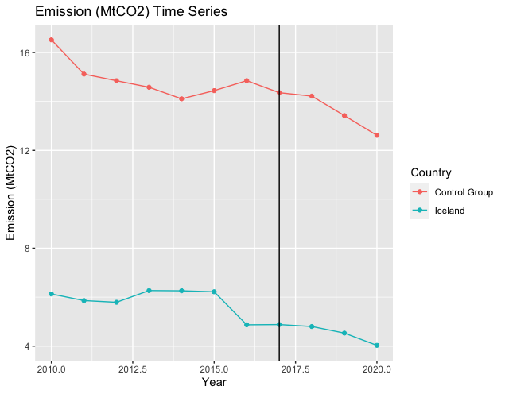
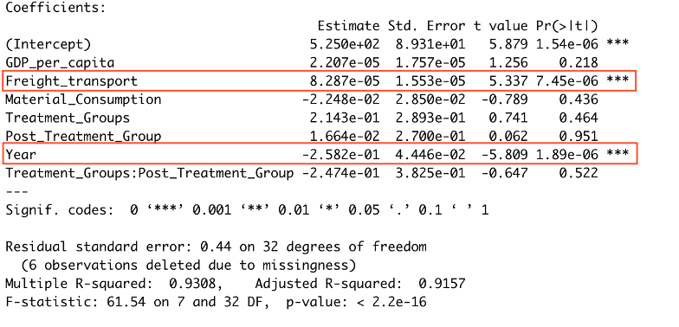
Difference-in-Difference Results: Industry

Slide 18
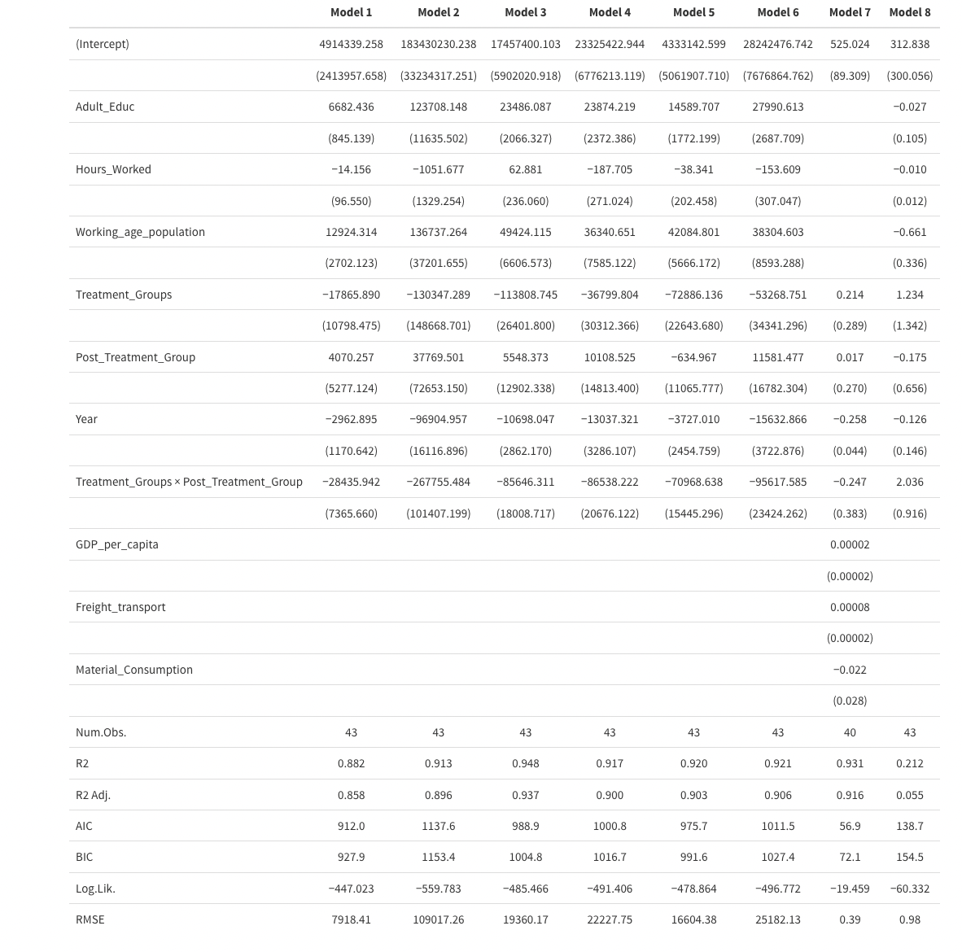

Slide 19
Conclusion
We found a significant difference in industry GDP after the implementation of the Iceland Trials for all six industries.
The labor productivity model produced a significant result indicating an increase in productivity after the end date of the Trials.
The interaction term was not found to be significant for our emissions model. Therefore, a conclusion cannot be reached that reducing the work week has statistical significance in reducing emissions.
Potential omitted variables cause our model to have some bias. Despite this, our research provides an incentive for future research on shorter work weeks.

